Slide 1
ADVANCED BUSINESS ANALYTICS
Group 16
AIM:
PREDICTING DEATH DUE TO HEART FAILURE BASED ON VARIOUS MEDICAL FACTORS
Somia Hota 58
Anurag Joshi 56
Stuti Mishra 28
Pooja Shrimankar 26

Slide 2
OBJECTIVES OF THE PROJECT
1
2
3
Relationship between smoking and BP
To plot the relation between sex and smoking
Predicting the death through heart disease/failure based on certain medical factors
Finding of the feature and importance using Extra Trees Classifier
4
5
6
To plot the relation between sex and aneamia
Various accuracies of disease of different classifier model based on all features
Finding the accuracy of different classifier model based on top 3 influencing features

Slide 3
DATA SET INFORMATION
Cardiovascular diseases (CVDs) are the number 1 cause of death globally
It takes an estimated 17.9 million lives each year
Heart failure is a common event caused by CVDs
This dataset contains 12 features that can be used to predict mortality by heart failure.
Certain parameters taken into consideration included anaemia,diabetes, ejection fraction, platelets, serum creatinine, serum sodium, sex, high blood pressure, creatine phosphokinase
REASON FOR CHOOSING THIS DATASET
People with cardiovascular disease or who are at high cardiovascular risk (due to the
presence of one or more risk factors such as hypertension, diabetes, hyperlipidaemia or
already established disease) need early detection and management wherein a machine
learning model can be of great help

Slide 4
DESCRIPTIVE STATISTICS FOR ANALYSIS
Death_Event | Age Mean std | Creatinine_phosphokinase Mean std | Ejection_fraction Mean std | Platelets Mean std | Serum_creatinine Mean std | Serum_sodium Mean std | Time Mean std
No (0) | 58.76 10.64 | 540.05 753.8 | 40.27 10.86 | 266657.49 97531.20 | 1.18 0.65 | 137.22 3.98 | 158.34 67.7
Yes (1) | 65.21 13.21 | 670.19 1316.5 | 33.47 12.53 | 256381.04 98525.68 | 1.84 1.47 | 135.37 5.00 | 70.86 62.37
Based on the above data, we get an idea that death was more prevalent with people having lower Ejection_fraction rate and time difference between sequential follow-ups

Slide 5






import pandas as pd
import numpy as np
import matplotlib.pyplot as plt
import seaborn as sns
import plotly.graph_objects as go
import plotly.express as px
from sklearn.preprocessing import StandardScaler
from sklearn.linear_model import LogisticRegression
from sklearn.ensemble import RandomForestClassifier
from sklearn.neighbors import KNeighborsClassifier
from sklearn.metrics import confusion_matrix, accuracy_score
The Libraries used

Slide 6
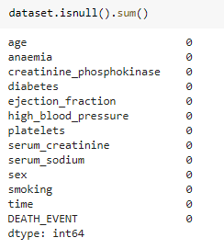
Data Pre-processing involves checking from missing values
data.isnull().sum()-function used to calculate the null values in the data frame
Data Pre-processing

Slide 7
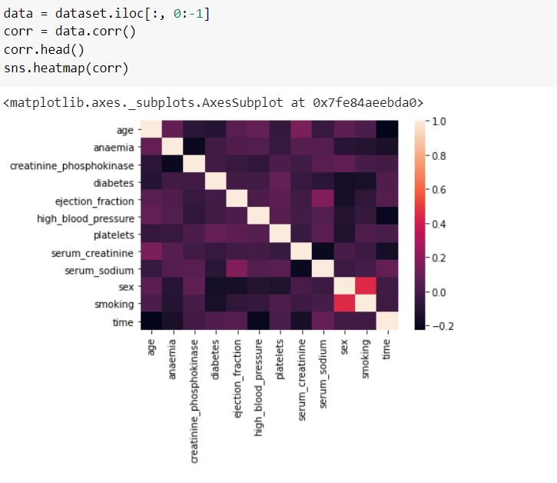
Correlation

Slide 8
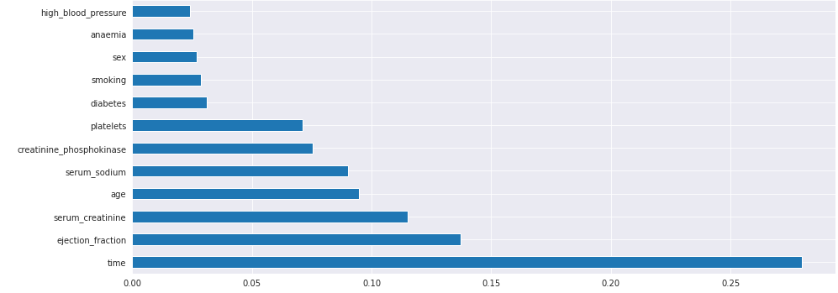
Feature Importance
Feature importance is an inbuilt class that comes with Tree Based Classifiers, we will be using Extra Tree Classifier for extracting the top 10 features for the dataset.
Feature importance gives us a score for each feature of your data, the higher the score more important or relevant is the feature towards your output variable.

Slide 9
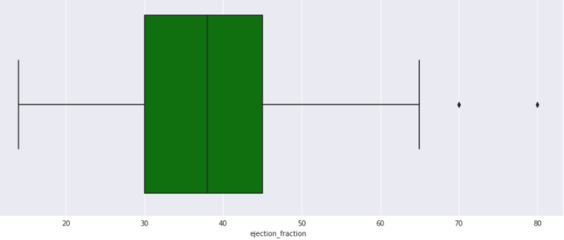
Outlier Detection
A normal heart’s ejection fraction may be between 50 and 70 percent.
A ejection fraction measurement under 40 percent may be evidence of heart failure or cardiomyopathy.
So, we are removing the outliers which are 70 and above

Slide 10
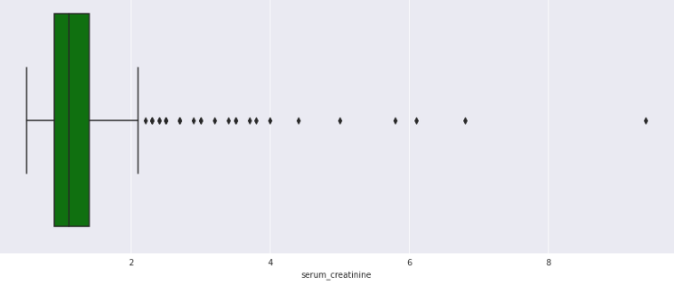
Outlier Detection
Creatinine levels in the blood can vary depending on age, race and body size
A creatinine level of greater than 1.2 for women and greater than 1.4 for men may be an early sign that the kidneys are not working properly
As kidney disease progresses, the level of creatinine in the blood rises.
With some research we found that all the values in serum_creatinine falls in possible range of values,so they are not outliers.They are actual data points that helps in predicting DEATH_EVENT.

Slide 11
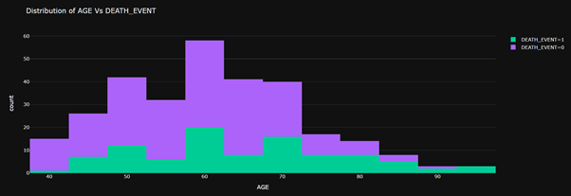
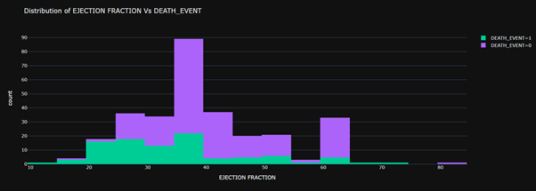
Data Visualization

Slide 12
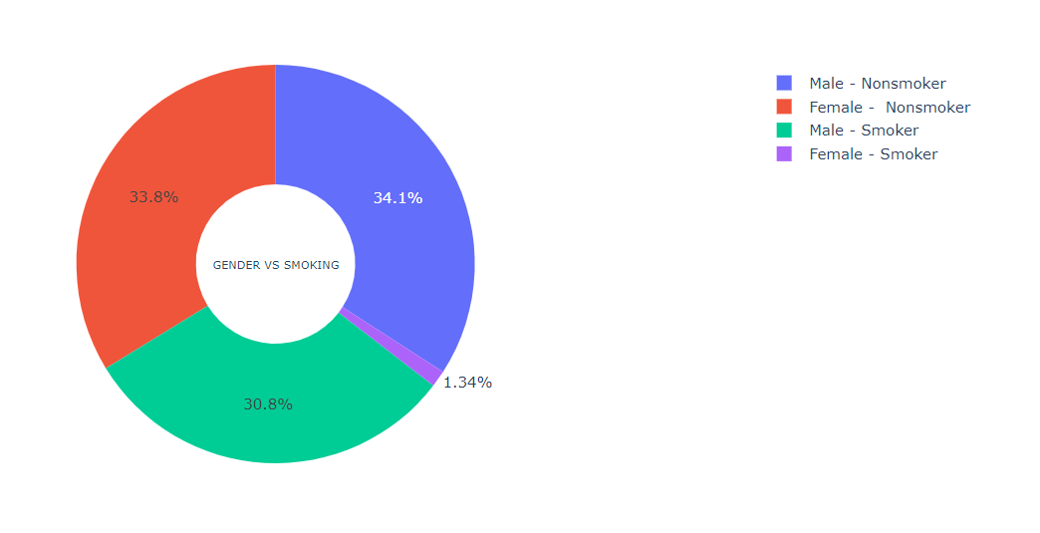
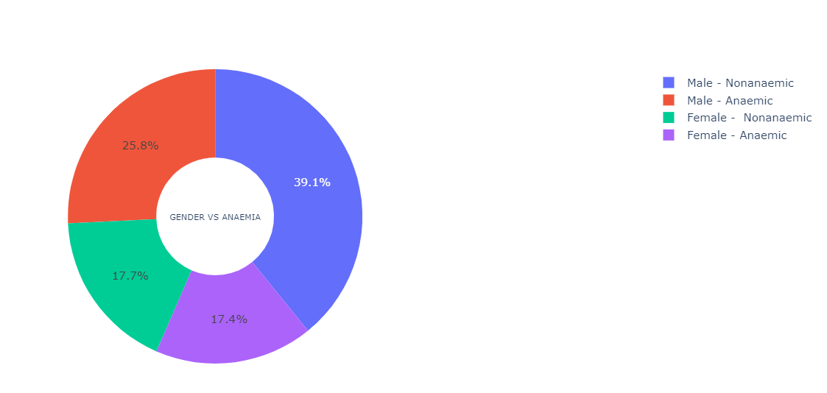
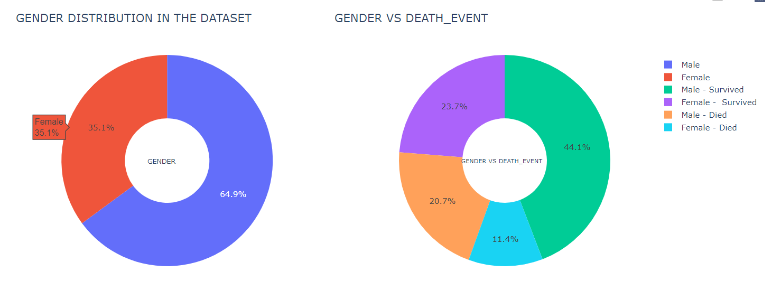
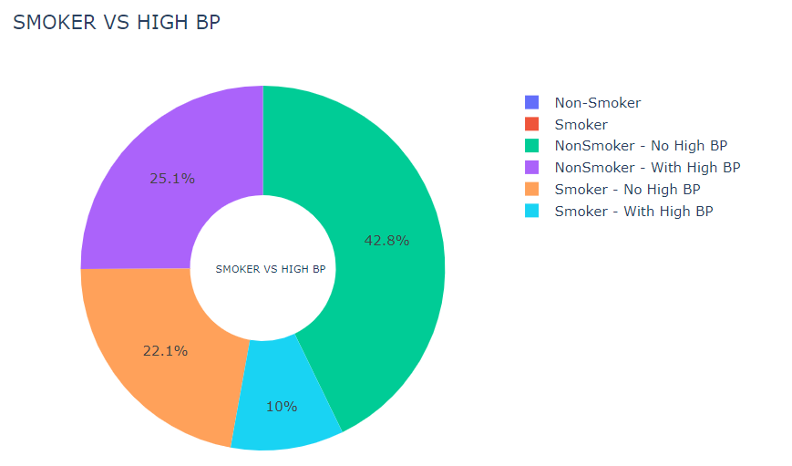
Some Insights

Slide 13


Model
Building
Logistic Regression with complete dataset
SPLITTING THE DATASET INTO TRAINING AND TESTING DATA:
x_train, x_test, y_train, y_test = train_test_split(x, y, test_size = 0.2, random_state =0)
Fit the Model:
classifier = LogisticRegression()
classifier.fit(x_train, y_train)
PREDICTING VALUES FOR TEST DATA:
y_pred = classifier.predict(x_test)
GETTING THE CONFUSION MATRIX AND ACCURACY SCORE:
cm = confusion_matrix(y_test, y_pred)
ac = accuracy_score(y_test, y_pred)
print(cm)
print(ac)
OUTPUT:

Slide 14
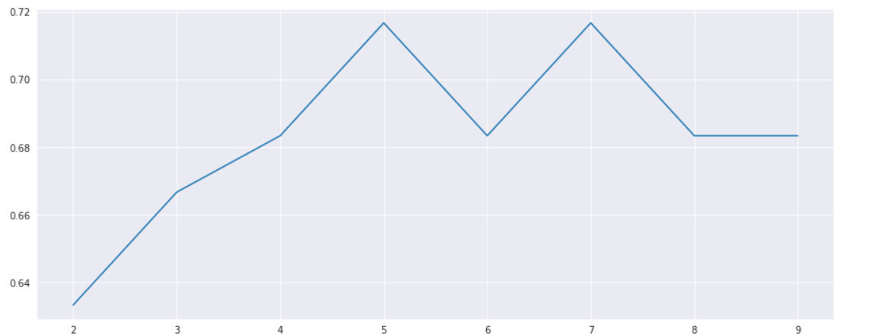

Model
Building
Kneighborsclassifier with complete dataset
SPLITTING THE DATASET INTO TRAINING AND TESTING DATA:
x_train, x_test, y_train, y_test = train_test_split(x, y, test_size = 0.2, random_state =0)
Fit the Model
list1 = []
for neighbors in range(2,10):
classifier = KNeighborsClassifier(n_neighbors=neighbors, metric='minkowski')
classifier.fit(x_train, y_train)
y_pred = classifier.predict(x_test)
list1.append(accuracy_score(y_test,y_pred))
plt.plot(list(range(2,10)), list1)
plt.show()
classifier = KNeighborsClassifier(n_neighbors=7)
classifier.fit(x_train, y_train)
PREDICTING VALUES FOR TEST DATA:
y_pred = classifier.predict(x_test)
GETTING THE CONFUSION MATRIX AND ACCURACY SCORE:
cm = confusion_matrix(y_test, y_pred)
ac = accuracy_score(y_test, y_pred)
print(cm)
print(ac)
OUTPUT:

Slide 15
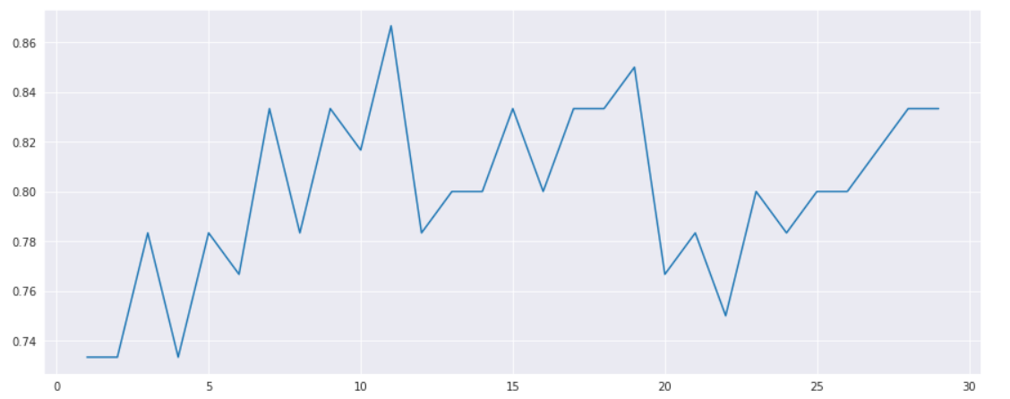

Model
Building
Random Forest Classifier with complete dataset
SPLITTING THE DATASET INTO TRAINING AND TESTING DATA:
x_train, x_test, y_train, y_test = train_test_split(x, y, test_size = 0.2, random_state =0)
Fit the Model:
for estimators in range(1,30):
classifier = RandomForestClassifier(n_estimators = estimators, random_state=0, criterion='entropy')
classifier.fit(x_train, y_train)
y_pred = classifier.predict(x_test)
list1.append(accuracy_score(y_test,y_pred))
plt.plot(list(range(1,30)), list1)
plt.show()
classifier = RandomForestClassifier(n_estimators = 11, criterion='entropy', random_state=0)
classifier.fit(x_train,y_train)
PREDICTING VALUES FOR TEST DATA:
y_pred = classifier.predict(x_test)
GETTING THE CONFUSION MATRIX AND ACCURACY SCORE:
cm = confusion_matrix(y_test, y_pred)
ac = accuracy_score(y_test, y_pred)
print(cm)
print(ac)
OUTPUT:

Slide 16
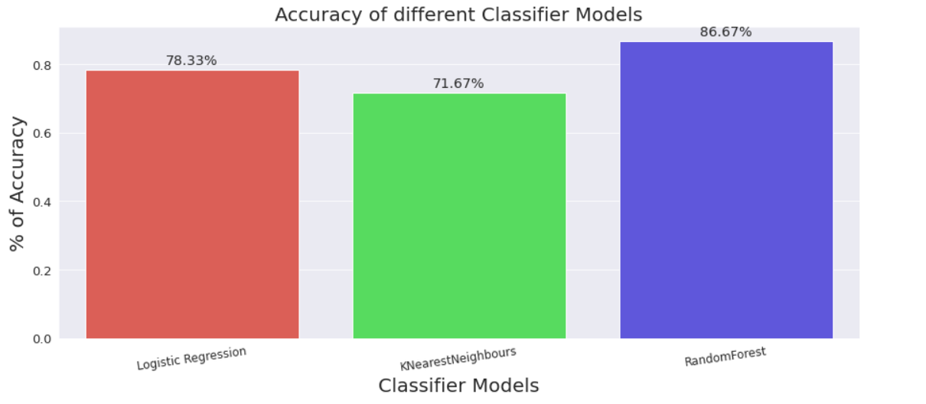

Slide 17
Model
Outcome
For building model, we have taken 3 classifiers.
Logistic Regression
KNearestNeighbours
RandomForest
From the built model, we get the accuracy of different classifier models in percentage of the data analyzed
Logistic Regression - 78.33%
KNearestNeighbours- 71.67%
RandomForest- 86.67%

Slide 18
Model
Building
Now we are building classifier models based on the top three important features found during Extra Tree classifiers.
These features are: - Ejection_fraction - Serum_creatinine - Time

Slide 19
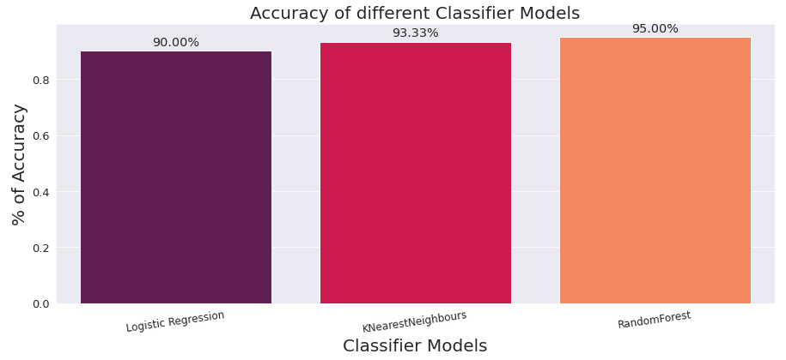
Serum creatinine , Ejection fraction and time are the important features to predict the death event found out using extra trees classifier
x = dataset.iloc[:, [4,7,11]]
y = dataset.iloc[:,-1]
The accuracy test was conducted on the basis of these features on 3 classifiers and we got the following results:
Logistic Regression - 90.00%
KNearestNeighbours- 93.33%
RandomForest- 95.00%

Slide 20
Conclusion:
Different classifier models have different accuracy levels.
Feature Selection can help in increasing the accuracy of the model.
The percentage of Male-Smokers are more than Female-smokers
In this case the RandomForestClassifier provided the best accuracy result
Future Scope/Work
Using more classifier models such as SVM, Decision Tree Classifier etc. for checking and enhancing( as applicable) of model accuracy.
More research on the defining the range of number of neighbors and number of estimators for Kneighborsclassifier and Random Forest Classifier respectively.

Slide 21
References:
Dataset Link: https://www.kaggle.com/andrewmvd/heart-failure-clinical-data Google Colab Link: https://colab.research.google.com/drive/12rMx5Z1Mjo2o1XOvmyw2PnUx_Sq7BGSu#scrollTo=GWYa3gm9iTmW GitHub Link: https://github.com/SomiaHota/HeartFailurePrediction_Trim4_Project

Slide 22
THANK YOU !

